Slide 1
TITLE: Design of High Voltage, Variable Output dc-dc converter for Hi-Rel Applications.

Slide 2
Application/Scope:
For optical communication, satellites generally use dual-axis mirrors for giving signals the required direction.
Those mirrors require to move in 2 axes (tip or tilt axis), and for the same, they require a variable voltage.
For this application, piezo devices can be used and this project is aimed at providing a variable voltage from 0Vdc-150Vdc from an input bus of 12Vdc.

Slide 3
Specifications and Components requirement:
Parameter | Value
Nominal input voltage | 12Vdc ± 20%
Output voltage | 0Vdc-150Vdc
Maximum output power | 2W
Size | 40mmX 60mm
Components required:
Capacitors
Inductors
MOSFET as a switch
PWM control IC
Microcontroller
Diodes
Resistors

Slide 4
Comparison:
Converter | Isolation | Active Components | Magnetics Required | Remarks
Boost | No | 2 | 1 Inductor | High Voltage Gain Not Possible, Step Down Not possible
Cascaded Boost | No | 4 | 2 Inductors | High voltage gain possible but Size constraint, step down not possible
Tapped Inductor Boost | No | 2 | Coupled Inductor | No Isolation
Buck-Boost | No | 2 | 1 Inductor | Step down possible, No isolation provided.
Flyback | Yes | 2 | Transformer/Coupled Inductors | Fits correctly in out scenario.

Slide 5
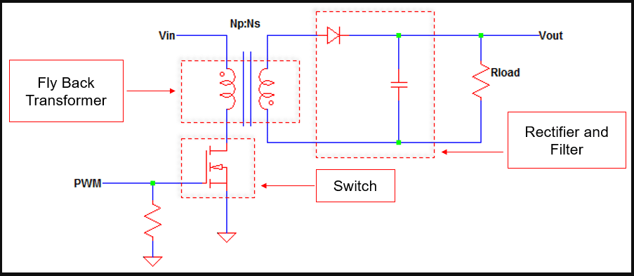
Flyback Working:

Slide 6
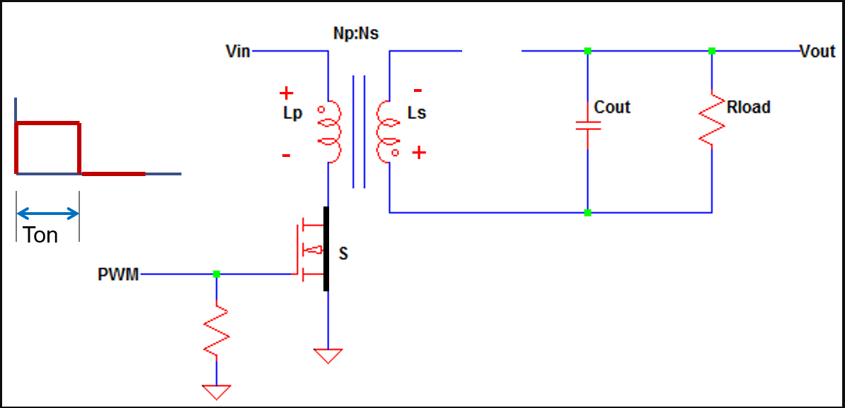
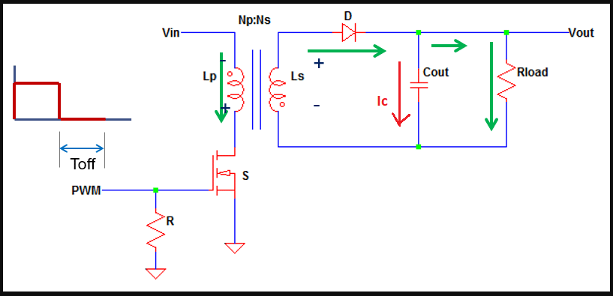
Flyback Working:
When Switch is ON
When Switch is OFF

Slide 7
Block Diagram:
PWM Controller IC
Flyback Converter
12Vdc Bus
0Vdc-150Vdc Output
In this case:
We will use in DCM (Discontinuous Conduction Mode).
Current Controlled Mode Preferred.
Isolated Converter.
Microcontroller

Slide 8
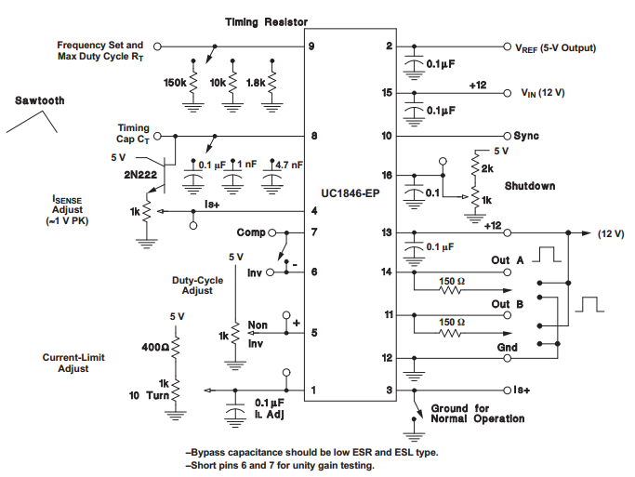
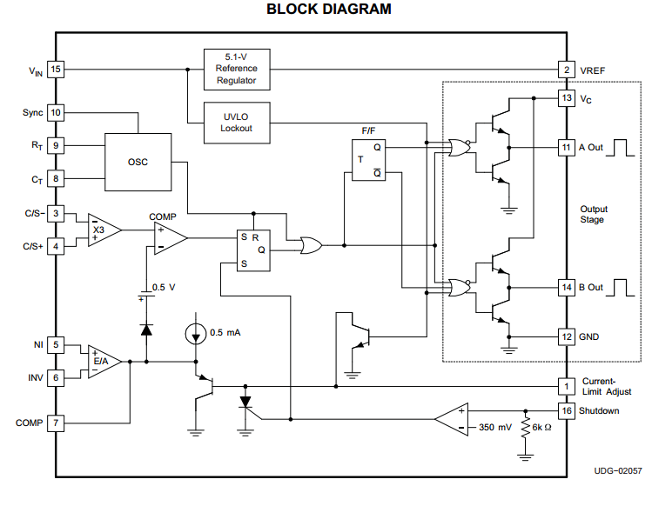
Simulations and Testing:
PWM IC
Open Loop Test Circuit
Internal Circuit

Slide 9
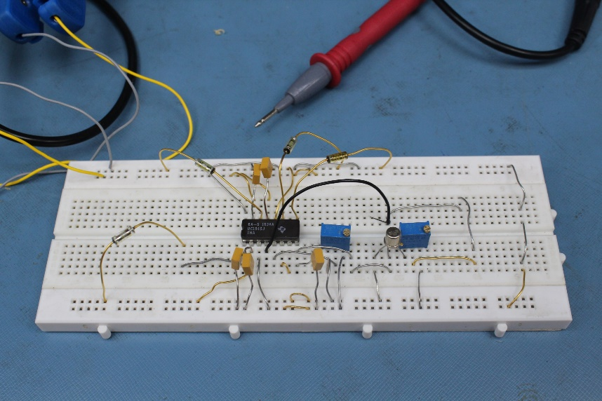
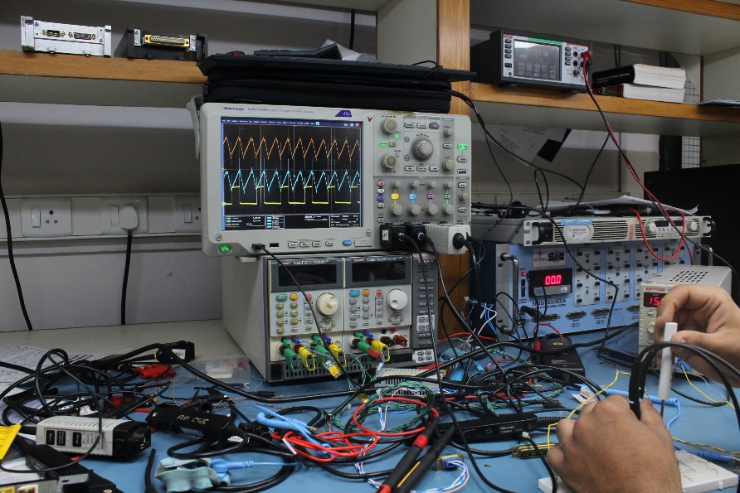
Simulations and Testing:
Controlled the PWM output (Duty cycle) from 0% to 50%, by changing the control input in an open-loop manner.
PWM control IC Open-Loop test
PWM Waveform

Slide 10
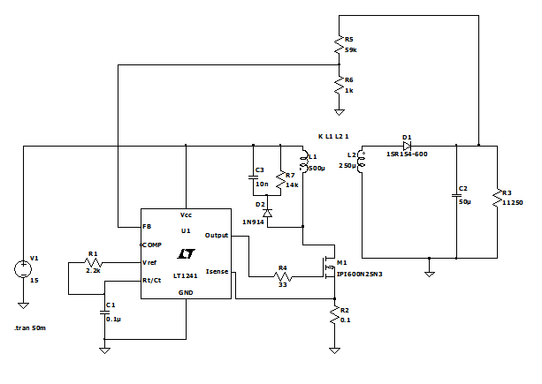
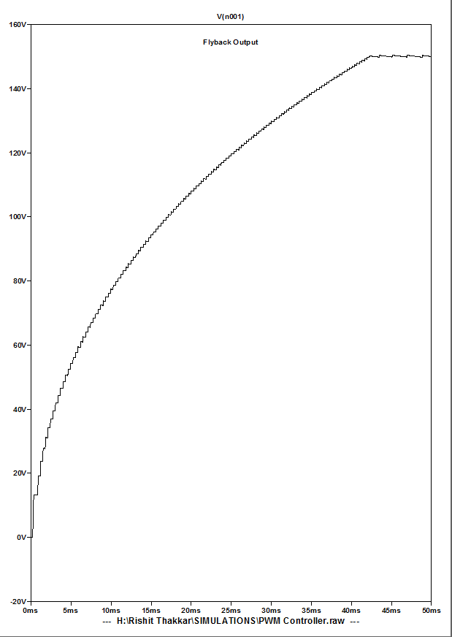
Simulations and Testing:
Flyback simulation with Equivalent PWM control IC

Slide 11
Work Completed:
Literature Review
Study and Calculations
Simulations and Comparative study
Component Selection (Under Progress)
Literature Study Sub points:
Resistors, Inductors, Capacitors, Diodes, OpAmp, etc.
Transistors(BJTs, MOSFETs)
Boost Converters
Flyback Converters
PWM Controller IC
Gate Driver IC
Terms Studied:
Continuous Conduction Mode
Discontinuous Conduction Mode
Voltage Control Mode
Current Control Mode
Duty Ratio
Isolated and Non-Isolated

Slide 12
Work to be done:
Schematic and PCB Design
Optimization of PCB Layout and Fabrication
Hardware Testing

Slide 13
Thank you

